Slide 1


Chronic Respiratory Disease:
Risk Modeling
Potential and Limitations
Alexander He
hea2@rpi.edu
Thilanka Munasinghe
munast@rpi.edu
Notes:
Hi everyone,
I’m Alex He, my coauthor is my advising professor Thilanka Munasinghe, and we are from RPI.
our paper is called
Chronic Respiratory Disease: Risk Modeling Potential and Limitations

Slide 2
Motivation
Chronic Respiratory Diseases (CRDs) are among the leading causes of mortality worldwide, with 545 million prevalent cases in 2017
Symptoms of non-infectious CRDs are often exacerbated by:
ambient air pollution
changes in temperature and humidity
Inspired by study where Machine Learning (ML) was successfully used to forecast the risk of Cholera outbreaks in India
Cholera Risk: A Machine Learning Approach Applied to Essential Climate Variables
Notes:
Chronic Respiratory Diseases (or CRDs), which are primarily noninfectious, are among the leading causes of mortality worldwide.
Symptoms of non-infectious CRDs are often exacerbated by: ambient air pollution, and changes in temperature and humidity
It is these relationships that presented an opportunity for us to build a model
Also, this study was inspired by another study where ML was used to forecast the risk of Cholera outbreaks in India, which I will talk about later

Slide 3
Datasets
Mortality (cause-specific counts of death)
Population
Shapefiles (counties and climate divisions)
Spatiotemporal datasets
Fine particulate matter (PM2.5)
Carbon emissions, biosphere fluxes, burned area
Climate variables, drought indices
Notes:
The datasets we used are
Mortality, Population, shapefiles
And spatiotemporal datasets for climate and air pollutants

Slide 4
Scope
Period of interest: 2000 - 2016
Monthly temporal resolution
Counties in contiguous U.S.
Notes:
The datasets we used overlap over the 2000-2016 period, and our intended resolution is for each datapoint to represent 1 month and 1 county in the contiguous United States

Slide 5
Mortality - Chronic Lower Respiratory Diseases (CLRDs)
CDC WONDER
Underlying Cause of Death
Includes:
asthma, emphysema, bronchiectasis, other COPDs (generally non-infectious)
Excludes:
influenza, pneumonia, other respiratory infections (infectious)
Notes:
Mortality data is from the CDC’s Underlying Cause of Death data. We included generally non-infectious diseases, classified under chronic LOWER respiratory diseases. Thus, we can model the effects of environmental factors without worrying about infectious agents.
The jif right here depicts the average monthly mortality rate of CLRDs of each year.

Slide 6
Population
Datasets - US Census Bureau
Monthly population totals for each county
Purpose: calculating mortality rate and population density
Notes:
We used population datasets from the US Census Bureau as part of calculating mortality rates and population density

Slide 7
Fine particulate matter (PM2.5)
Atmospheric Composition Analysis Group
Washington University in St. Louis
0.01° × 0.01° grid
µg m⁻³
Notes:
Fine particulate matter, or PM2.5, is measured in micro-grams per cubic meter
The dataset we used is from the Atmospheric Composition Analysis Group at WashU, and it has a resolution of 0.01 coordinate degrees
So this jif shows the monthly PM2.5 concentrations at that resolution.

Slide 8
Carbon Emissions, Biosphere Fluxes, Burned Area
Global Fire Emissions Database (GFED)
0.25° × 0.25° grid
Carbon emissions g C m⁻²
Biosphere Fluxes g C m⁻²
net primary production (NPP)
C gained (photosynthesis) minus C released (plant respiration)
heterotrophic respiration (R_{h})
fire emissions (BB)
Burned area
Fraction of each grid cell that burned in each month
Actual area - calculated with grid cell area data provided
Notes:
The Global Fire Emissions Database provided datasets for carbon emissions and biosphere fluxes measured as grams of carbon per meter squared, and burned area as the fraction of each grid cell.
They all have a resolution of 0.25 coordinate degrees.

Slide 9
Climate Variables, Drought Indices
NOAA Monthly U.S. Climate Divisional Database (NClimDiv)
By climate divisions
Climate variables
Temperature
Precipitation
Drought indices; negative = dry spells, positive = wet spells
Palmer Drought Severity Index (PDSI); -6 to +6
balance between moisture supply and demand.
Standardized Precipitation Index (SPI, SP01 for monthly); -3 to +3
0 = median of precipitation for particular location
Notes:
NOAA provides climate variables and drought indices, aggregated by climate division
The climate variables we used are temperature and precipitation
While humidity is an exacerbating factor, we unfortunately could not find a dataset for humidity at our intended resolution, at NOAA or elsewhere, so we had to use precipitation and drought indices to act as a proxy for humidity.
The drought indices we used are PDSI and SPI. For both indices, negative values indicate dry spells and positive values indicate wet spells. For SPI, a zero indicates the median precipitation for a particular climate division, so it measures deviations from the long-term climatology of a particular climate division.

Slide 10
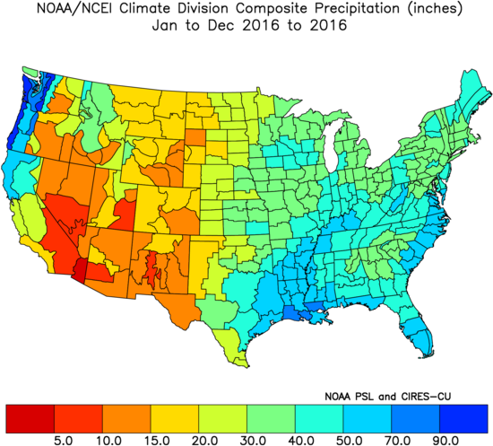
Total Precipitation, 2016
NOAA/NCEI U.S. Climate Division Data Plots: NOAA Physical Sciences Laboratory
Notes:
For an example of the NOAA data, this is total precipitation for 2016
As you can see, climate divisions don’t follow county boundaries, so the data was rasterized to a 0.01 x 0.01 grid, before being aggregated by county

Slide 11
Shapefiles - Counties, Climate Divisions
Boundaries - collections of points; polygons
Counties - Cartographic Boundary Files - US Census Bureau
Metadata
Location codes for county and state
Land + water area of each county
Purpose:
Determining the grid cells in each county (or climate division)
Calculating county population density
Notes:
Shapefiles were used to find the grid cells in each county or climate division.
The county shapefiles also included location codes and area
For our model, we tested variables for population densities adjusted by both land area and total area

Slide 12
Data Preparation
Convert to identical 0.01° × 0.01° grid beforehand
Aggregate all spatiotemporal datasets by county and month
Adjust by total area of grid cells in each county
Include 1- and 2-month lags for spatiotemporal variables
Fine particulate matter (PM2.5)
Carbon emissions, biosphere fluxes, burned area
Climate variables, drought indices
Update county boundaries and designations
Changes to Counties and County Equivalent Entities: 1970-Present - US Census Bureau
Notes:
To prepare the data, we first converted all spatiotemporal datasets to a matching 0.01 coordinate degree grid
Then aggregated by county and month
To measure potential lagging effects, ee also included datasets for 1 and 2 month lags for all spatiotemporal variables
We also had to account for several changes to counties between 2000-2016

Slide 13
Methods
70:30 train-test split
Random forest regression (scikit-learn)
10-fold cross validation
Hyperparameter tuning to optimize model
Feature selection - recursive feature elimination
Optimize R-squared
Collinearity analysis with Spearman rank correlation (SciPy)
Improves discussion of variables’ potential contributions to the model
Notes:
To evaluate our model, we used 30% of all datapoints for a test dataset and the remaining 70% for training with cross validation
We used scikit-learn’s random forest regression as the model and recursive feature elimination to select features,
R-squared was the metric we evaluated against in order to optimize the model
Also, we performed Collinearity analysis with Spearman rank correlation, which helped with inferring the best features and enhanced our discussion about variable contributions

Slide 14
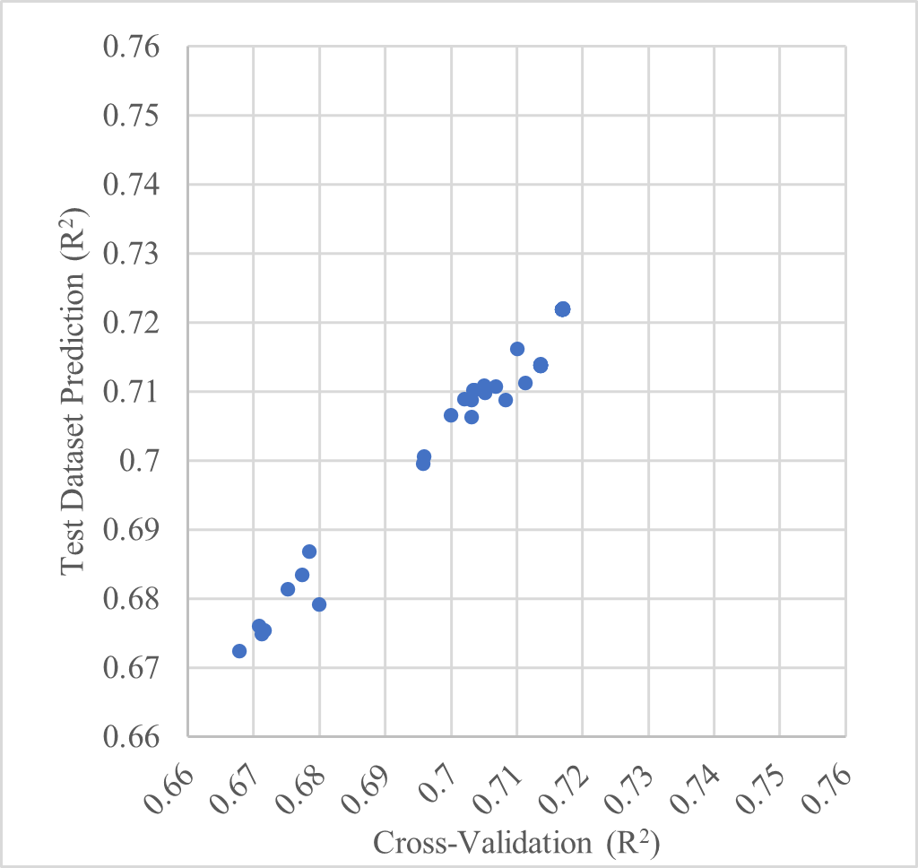
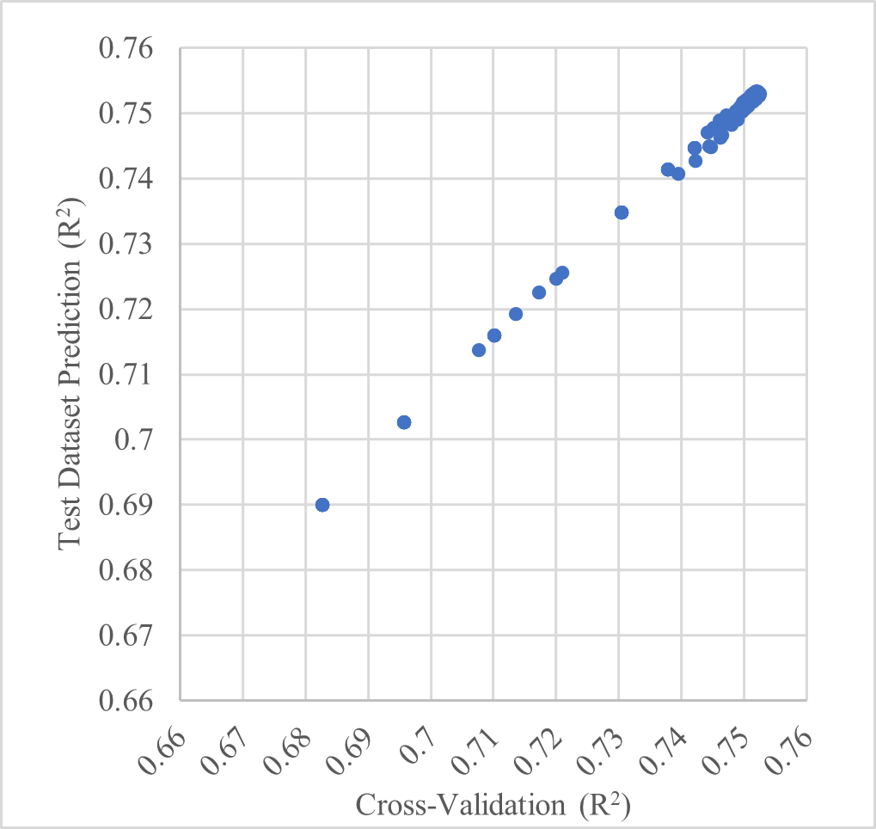
Results
During RFECV iterations
R-squared
0.7526 - cross validation
0.7528 - test dataset prediction
Similar trends between cross-validation and test dataset prediction
Suggests model generalizes well for unseen data
During hyperparameter tuning (after RFECV)
Notes:
Our best R-squared values are approximately 0.75, with cross validation and test dataset prediction being not much different and having similar trends across iterations. This suggests that our model may generalize well for unseen data

Slide 15
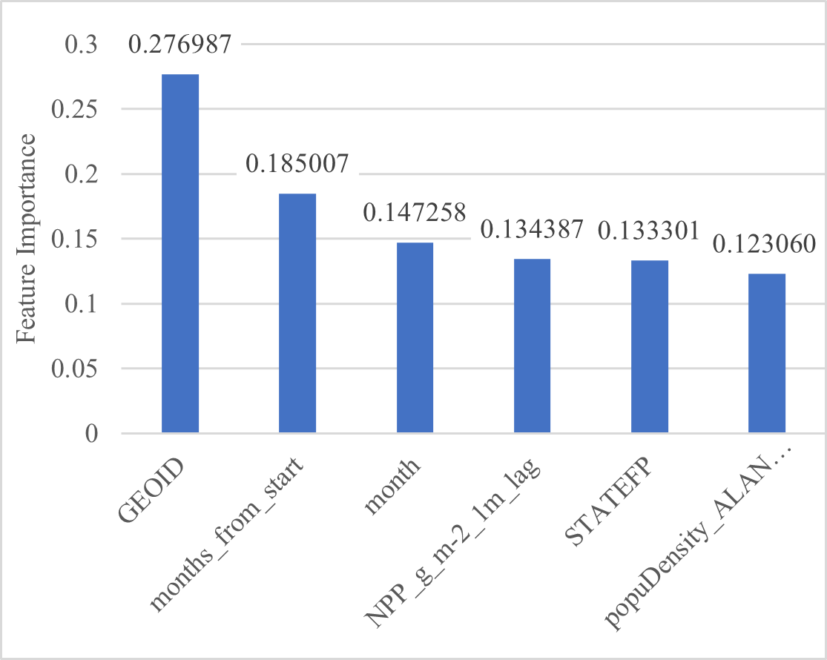
Results - Selected Features
GEOID - county encoder
Months from start of period (since January, 2000)
Month of the year
Net primary production (NPP), lagged by 1 month
STATEFP - state encoder
Population density, adjusted by land area
Notes:
So these are the final selected features and their importance values.
They include the location encoders for county and state, months from the start of the period, month of the year, population density adjusted by land area, and net primary production lagged by one month.
Besides the location encoders for county and state, we tested a total of 43 variables when including the lagged variables, or a total of 19 variables without the lags
In our discussion, we use past research to explain the potential contributions of the included variables. This includes studies investigating the exacerbating effects of particulate matter, temperature, humidity, et cetra, but on much finer resolutions, such as in individual cities and within durations of a few days or even hours.
While our explanations are rather speculative, our goal was to show that there are many research areas that, as they develop, can contribute to this type of study in the future.

Slide 16
Data Limitations
Using mortality as target variable
Mortality only captures most extreme cases of disease exacerbation
Limited data of Emergency Room Visits (ERVs) by county
ERVs by country - commonly used to measure disease exacerbation
Estimates of the Global Burden of Ambient PM2.5, Ozone, and NO2 on Asthma Incidence and Emergency Room Visits
Mortality data - suppression constraints
Data points with less than 10 deaths are unavailable
Estimated based on state total
Monthly, county-level datasets not available for:
Humidity
Used precipitation, drought indices instead
Ground-level ozone
estimated asthma ERVs in 2015:
Ozone: 9–23 million
PM2.5: 5–10 million
Notes:
The limitations of our model are largely due to what data is publically available at our intended resolution.
We used mortality as the target variable, but this is not the best way to measure risk, since mortality only captures most extreme cases of exacerbation. A better way to measure risk is through Emergency Room Visits, or ERVs. This was the approach of a large collaborative study that estimated the global burden of air pollutants by country for 2015, measured as ERVs attributable to each pollutant. But their resolution was the total ERVs for a single year and by country. The amount data reported by county hospitals may vary, so it is much more difficult to compile ERV data by county.
Also, the mortality data is subject to suppression constraints for privacy reasons, where, for any county in a given month, the exact number of CRD deaths is unavailable if its less than 10, so these values had to be estimated based on the state total for that month.
Finally, datasets at our intended resolution were not available for
humidity, as I mentioned before, and
ground-level ozone, which according to the global burden study, is estimated to have a greater impact on ERVs than PM2.5.

Slide 17
Other Limitations
Coarse resolution - monthly, county-level datasets cannot represent phenomena present in finer spatiotemporal resolutions (i.e. cities, days)
Air pollution and emergency department visits for respiratory diseases: A multi-city case crossover study
ERVs for respiratory diseases increase after days with higher concentrations of pollutants
Lagging effect on ERVs lasts only several days
Excluded factors
tobacco smoking (human behavior)
airborne allergens
Many “non-infectious” lung diseases are influenced by infectious microorganisms
active area of investigation
Notes:
Besides data limitations, another limitation is our coarse resolution, as monthly, county-level datasets cannot represent phenomena found on finer spatiotemporal resolutions.
An example is a study that used ERVs to measure the effects of air pollutants within multiple cities. They found that
ERVs increase after days with higher concentrations of pollutants, and the lagging effect on ERVs lasts several days.
So clearly, these phenomena cannot be represented in a monthly, county-level study
Another limitation is excluding factors such as smoking and airborne allergens. Smoking is particularly subject to human behavior.
Also, the effects of infectious microorganisms may influence diseases that are considered non-infectious, but this is an active area of investigation
8

Slide 18
Comparison - Cholera Outbreaks in India
Cholera Risk: A Machine Learning Approach Applied to Essential Climate Variables
Random forest classification (scikit-learn)
Essential Climate Variables (ECVs)
Chlorophyll-a, Land/Sea Surface Temperature, Soil Moisture, Total Precipitation, etc
Vibrio cholerae
Infectious; prevalent in coastal areas
Strong spatiotemporal relationships between ECVs and distribution of V. cholerae bacteria
Allows accurate predictions of cholera outbreaks
Sensitivity = 0.895; correctly identified 89.5% of outbreaks
ROC = 0.984
Notes:
As I mentioned earlier, this study drew inspiration from another study where Machine Learning (ML) was used to forecast the risk of Cholera outbreaks in India.
They used a similar approach with random forest, but for classification instead of regression, for whether there is or is not an outbreak.
Their model was very successful, with 89.5% of outbreaks correctly identified in the test dataset. This is due to strong relationships that exist between Essential Climate Variables and the distribution of Cholera bacteria

Slide 19
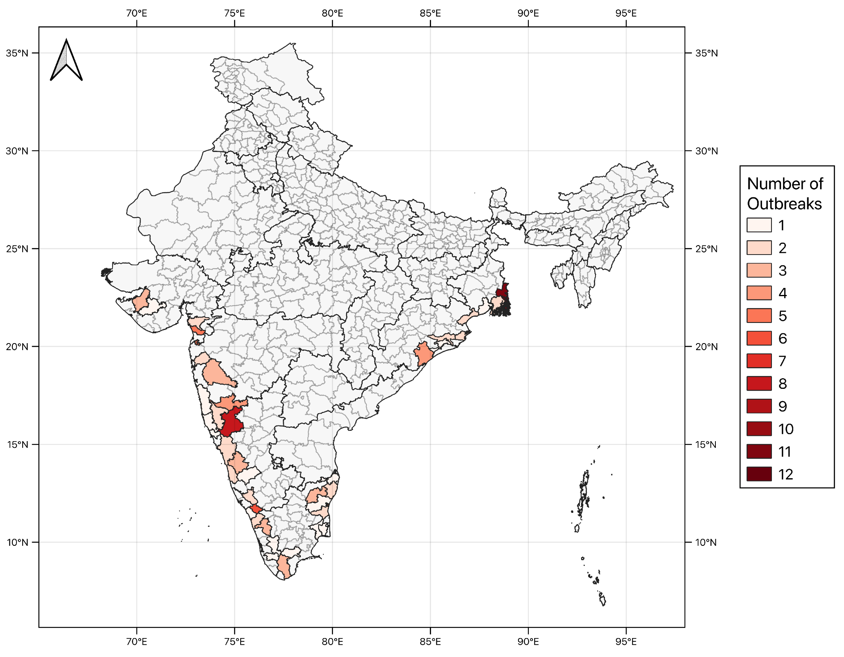
Number of cholera outbreaks reported; 40 coastal districts; 2010 - 2018
Notes:
So This map is from that paper, showing the number of cholera outbreaks in the 40 coastal districts of India, between 2010-2018

Slide 20
Main conclusions
Significant potential for modeling CRD risk (R-squared ≈ 0.75)
Limitations
data limitations
phenomena only found on finer spatiotemporal scales (i.e. cities, days)
primarily non-infectious nature of CRDs
Caveats of ML
can naively test for features that improve model performance
mechanisms behind their relationships remain unclear
Accessible data of climate variables may improve estimates of ERVs attributable to specific pollutants
Estimates of the Global Burden of Ambient PM2.5, Ozone, and NO2 on Asthma Incidence and Emergency Room Visits
Notes:
So our main conclusions are that, given the moderate R-squared values despite current data limitations, there is significant potential for modeling CRD risk on the monthly and county scale
However, data limitations, phenomena only found on finer spatiotemporal scales, and the primarily non-infectious nature of CRDs present challenges.
We also mentioned the caveats of ML applicable to this type of study, which is that we can naively test for features that improve model performance, but the mechanisms behind their relationships remain unclear.
Finally, we tied into the paper mentioned before, that estimated the global burden of air pollutants by country for 2015, measured as ERVs attributable to each pollutant. They did not factor in climate variables in their estimates, but given the connections with CRD exacerbation, doing so may improve these estimates, thought further research may be needed to better quantify the effects of climate variables.

Slide 21
Next Steps
Use better methods for hyperparameter tuning
Gradient-based rather than grid search
Address asymmetry of importance
imbalanced regression
Use different ML techniques
neural networks
Use datasets from alternative sources
Datasets may be developed differently
New datasets may appear in the future
Notes:
For possible next steps, we identified common modeling techniques, that can further improve on our methods, such as using better methods for hyperparameter tuning, performing imbalanced regression, and using different ML techniques such as neural networks
Also, using datasets from different sources can help evaluate the model as well, but of course this depends on data availability, which will most likely improve as time goes on
Alright, thanks for listening.

